Slide 1
Phase 2 Progress Review Discussion Template
GSA, Office of Shared Solutions and Performance Improvement
Month, Year

Slide 2
Questions to be Answered
This template is intended to guide a Progress Review discussion between a Customer, Provider and Key Stakeholders.
Questions to Be Answered
 | Does the proposed solution offered by the provider meet standard requirements identified by the Service Area Managing Partner, including federal requirements, and OSSPI approved mission-specific requirements needed by the agency?
 | Has there been sufficient market research conducted on providers?
 | How inclusive is the risk analysis? Is the migration schedule realistic and achievable? Is the selected provider adequately resourced and prepared to support the new customer in the migration planning and migration phases? Is the customer adequately resourced and is the organization ready to begin the migration planning Phase? Are the scope of services and migration planning phase roles and responsibilities adequately defined and understood between customer and provider? Does the program have adequate plans to mitigate key risks and issues, and have contingency plans?
 | Has the LCCE been updated to reflect business requirements, and is it reasonable?
 | Do the customer and provider efforts align with each office initiative?
2. Selection

Slide 3
Instructions for Completing This Template
This template is intended to guide a Progress Review discussion between a Customer, Provider and Key Stakeholders.
To use this template:
Use the source documents included within each slide to develop summary-level information that will help guide the Progress Review
Be prepared to discuss specific questions/content included on each slide before or during the Progress Review
Once complete, schedule a Progress Review meeting

Slide 4
Documentation Required for Phase 2 Progress Review
The following documentation is required in guiding a discussion to demonstrate readiness and gain approval for Phase 2. Agencies purchasing transaction processing services only will identify relevant activities and artifacts for their project using the M3 Services Tailoring Guide.
Phase 2 Documentation
Acquisition Strategy Business Needs Workbook Business Process Reengineering Strategy Change Management Plan Change Readiness Assessment Communications Plan Cost Estimates Data Cleansing Plan Data Cleansing Scripts Decommission Plan Governance Plan Implementation Approach/Schedule Independent Verification and Validation (IV&V) Plan | Initial Master Schedule Labor Relations Strategy Life Cycle Cost Estimate (LCCE) M3 Risk Assessment Tool Program Management Plan Provider Agreement Provider Assessment Report (Federal Only) Request for Proposal (RFP) (Commercial Only) Resource Management Plan Risk Management Plan Risks, Actions, Issues, and Decisions (RAID) Log Stakeholder Analysis Status Reports/Dashboards Target State Concept of Operations Validated As-Is Process Maps
Information Contained in Progress Review Discussion
Acquisition Strategy Business Needs Workbook Change Management and Communication Approach Data Management/Data Quality Approach Decommission Plan Initial Master Schedule Overview Labor Relations Strategy LCCE M3 Risk Assessment Tool Provider Agreement Provider Selection Summary Request for Proposal (RFP) (Commercial Only) Resource Management Plan Overview (Provider) Resource Management Plan Update (Customer) Scope of Services Overview Top Risks
Exit Criteria (to move into Phase 3)
Business Needs Workbook Communications to Stakeholder Delivered Data Cleansing Commenced Initial Master Schedule Updated LCCE Mitigation Plans in Place for Major Risks/Issues | Provider Agreement Provider Selected Staffing Plan Ready for Execution

Slide 5
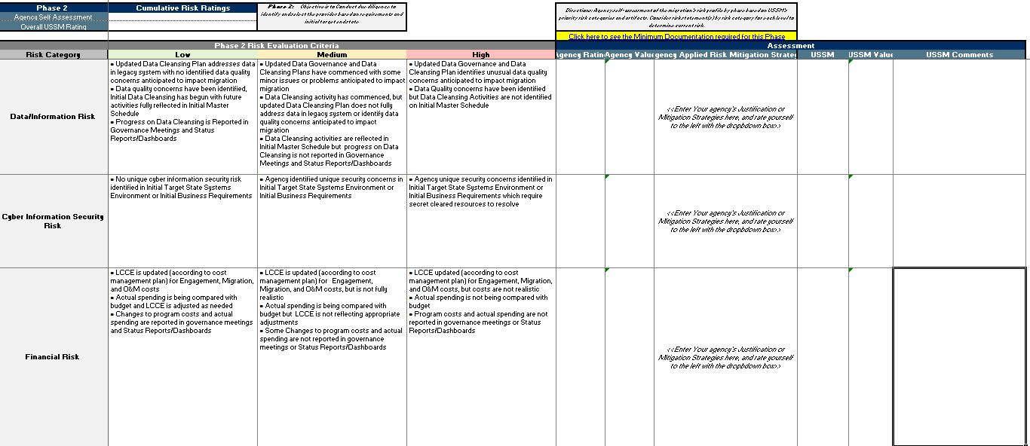
M3 Risk Assessment Tool
Determine the risk rating at the end of Phase 2 using the M3 Risk Assessment Tool and submit with Progress Review material.
ILLUSTRATIVE

Slide 6
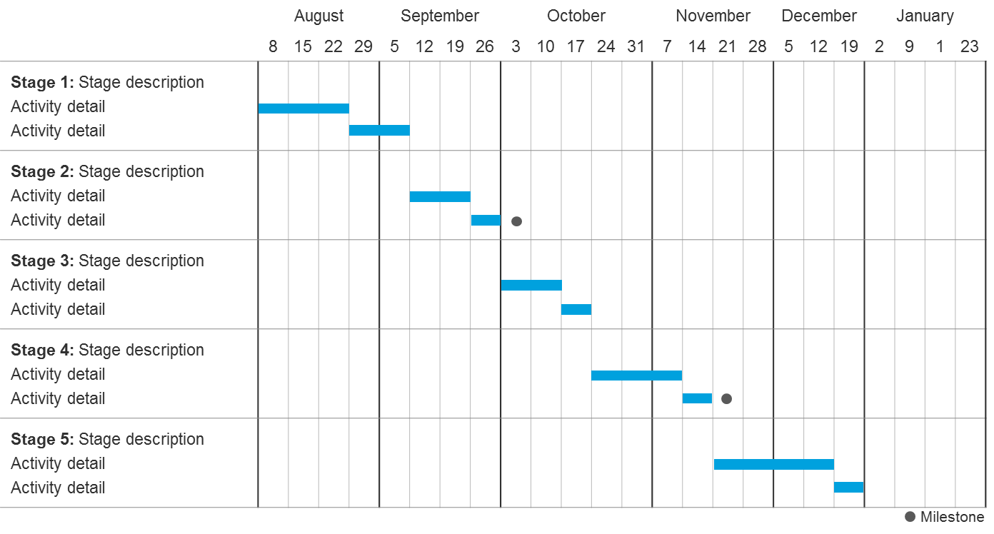
Initial Master Schedule Overview
Provide an overview of the Initial Master Schedule as of Phase 2
Provide an updated Master Schedule, which should include in addition:
Estimated migration schedule from Provider Selection
Estimated RFP release and award timeline (Commercial Only)
**Provide information by month and year
ILLUSTRATIVE
Source Documentation from Playbook
Initial Master Schedule

Slide 7
Life Cycle Cost Estimate
Provide the estimated cost based on the LCCE*.
Develop the life cycle cost information for Phase 2 based on any changes or refinement in scope of the program from when the Project Business Case was developed
Estimated Costs for Migration and Operations and Maintenance (O&M)
Responsible Party (Provider, Agency, Other) | Migration Cost Category / Work stream | FY N CPM | FY N+1 CPM | FY N+2 CPM | FY N+3 CPM | Total CPM | Cost Calculation | Required FTEs | Notes/Assumptions
 | Program Management Support
 | Data Conversion Support
 | Change Mgmt./Train
 | Business Process Reengineering
 | Systems Engineering
 | <Project or Organization Determined>
 | Total Migration
Provider | <Service Layer 1>
Provider | <Service Layer 2>
Agency | <Agency Cost>
 | Total O&M
Grand Total
ILLUSTRATIVE
*To avoid duplication of effort, agencies are encouraged to use their existing budgetary documentation, when available, to provide cost estimates.
Source Documentation from Playbook
LCCE

Slide 8
Provider Selection Summary
Provide overview of how a provider was selected or will be selected based on decision to use a commercial or federal provider
Federal Provider
Commercial Provider
Describe the following:
The approach and results of your market assessment
Which Federal provider was selected, criteria used for selection, and the rationale for selecting the provider
Provide an overview of:
The approach and results of your market assessment
The justification for using a commercial provider
The scope of services you will be requesting within the Request for Proposal (RFP)
The timeline and plan for issuing the RFP
Source Documentation from Playbook
Provider Assessment Report

Slide 9
Resource Management Plan Update (Customer)
Provide an Organization Chart and indicate required number of full time equivalents (FTEs)/resources, existing resource gaps, and plan to fill resource gaps
Consider including the following:
The roles and responsibilities needed for the customer migration team for Phase 3
Total number of resources needed and total number of resources staffed
The percentage of time required for each position on the customer migration team
Vacant positions and plan to fill each position
For each role, indicate if resources are in an acting, detailed, or contractor-filled position
Source Documentation from Playbook
Resource Management Plan

Slide 10
Resource Management Plan Overview (Provider)
Provide an Organization Chart and indicate required number of full time equivalents (FTEs)/resources, existing resource gaps, and plan to fill resource gaps
Consider including the following:
The roles and responsibilities needed for the provider migration team for Phase 3
Total number of resources needed and total number of resources staffed
The percentage of time required for each position on the provider migration team
Vacant positions and plan to fill each position
For each role, indicate if resources are in an acting, detailed, or contractor-filled position
Source Documentation from Playbook
Resource Management Plan

Slide 11
Scope of Services Overview
Describe which services the organization desires for migration and Operations and Maintenance (O&M)
Migration
O&M
Describe required migration services (e.g., training, data conversion, systems integration) from the provider
Describe required O&M services, including:
Desired service (e.g., Financial Management, HR, Acquisition)
Function (e.g., Payable Management)
Description of services (i.e., transaction processing, business application support)
Source Documentation from Playbook
Business Needs Workbook Draft Request for Proposal (RFP) (Applies to Commercial Only)

Slide 12
Acquisition Strategy
Provide the details around planned procurements to support the migration
Potential data points could include:
Planned procurements for future phases, including provider Request for Proposals (RFPs) (if Commercial):
Planned Procurement (including Scope) | Acquisition Strategy | Status* | Planned Contract Value | Expected Award Date | Expected Period of Performance
Data Conversion: Provide services to extract and translate data from legacy application…
ILLUSTRATIVE
*Statuses may include: Early Planning, Requirements Defined, RFP Released, Award Complete
Source Documentation from Playbook
Acquisition Strategy

Slide 13
Change Management and Communications Approach
Describe the approach and strategy for change management, communications, and stakeholder management
Consider providing updates to the following:
The stakeholders that will be impacted by the migration
The change management activities that are planned for the program lifecycle with activity owners for the following:
Business Process Re-engineering
Communications
Training
Workforce Alignment
Source Documentation from Playbook
Communications Plan

Slide 14
Labor Relations Strategy
Describe the expected impact on labor relations
Consider including the following information:
What are the collective bargaining agreements that are impacted?
What is the plan to negotiate with unions?
Source Documentation from Playbook
Labor Relations Strategy

Slide 15
Data Management/Data Quality Approach
Provide an overview of the data management and quality approach including an overview of findings from the initial data assessment
Considering providing updates to the following:
The results of your data quality assessment
Data cleansing activities that have already begun
The timeline for future data cleansing activities
Success criteria used to measure data quality
Source Documentation from Playbook
Data Governance Model Data Cleansing Plan

Slide 16
Top Risks
Provide the top 5 – 10 risks identified to date and proposed mitigation strategies
Risk | Impact | Probability | Owner | Mitigation Strategy
<Risk 1: If adequate resources are not dedicated to data cleansing, then cleansing activities will be delayed and the quality of the conversion will be reduced> | High | Medium | Program Manager | <Dedicate additional resources to support data cleansing efforts no later than 5/5>
Source Documentation from Playbook
Risks, Actions, Issues, and Decisions (RAID) Log Risk Management Plan

Slide 17
Next Steps
Please describe the activities planned for the next 30, 60, and 90 days

